Slide 1
ARTIFICIAL INTELLIGENCE Week 1
Dr. Momina Moetesum

Slide 2
Course Introduction
ARTIFICIAL INTELLIGENCE
Course Code: | CSC-411, CSL-411 (Lab)
Credit Hours: | 3+1
Pre-requisite: | Discrete Mathematics
Course Objectives
The key objectives of this course include: To get the historical perspective and foundation of artificial intelligence. To learn the applications and trends of artificial intelligence. To get familiarity with basic artificial intelligent techniques for problem solving, decision making, knowledge representation, inference, planning and learning. Investigate applications of AI techniques in intelligent agents, expert systems and machine learning models.
Resources
Russell, S. and Norvig, P. “Artificial Intelligence. A Modern Approach”, 4th ed, Prentice Hall, Inc., 2020. Luger, G.F. and Stubblefield, W.A., 2009. AI algorithms, data structures, and idioms in Prolog, Lisp, and Java. Pearson Addison-Wesley Artificial Intelligence: The Basics, Kevin Warwick, Routledge, 2013

Slide 3
Course Introduction
Course Contents
Introduction (Introduction, basic component of AI, Identifying AI systems, branches of AI, etc.); Problem Solving by Searching (Informed searching, Uninformed searching, Local searching.); Constraint Satisfaction Problems; Adversarial Search (Min-max algorithm, Alpha beta pruning, Game-playing); Reasoning and Knowledge Representation (Introduction to Reasoning and Knowledge Representation, Propositional Logic, First order Logic);Learning (Unsupervised learning, Supervised learning, Reinforcement learning) ;Uncertainty handling (Uncertainty in AI, Fuzzy logic); Recent trends in AI and applications of AI algorithms (trends, Case study of AI systems, Analysis of AI systems)

Slide 4
Course Introduction
Mapping of CLOs to PLOs
PLOs/CLOs | CLO1 | CLO2 | CLO3 | CLO4
PLO1 (Academic Education) | ✔
PLO2 (Knowledge for Solving Computing Problems) |  | ✔
PLO3 (Problem Analysis) |  |  | ✔
PLO4 (Design/Development of Solutions) |  |  |  | ✔
PLO5 (Modern Tool Usage)
PLO6 (Individual and Teamwork)
PLO7 (Communication)
PLO8 (Computing Professionalism and Society)
PLO9 (Ethics)
PLO10 (Life-long Learning)
OBE System Implementation
Course Learning Outcomes
After successful completion of this course, the students should be able to: | PLO | BT Level
Understand key components of artificial intelligence. | 1 | C2
Implement classical artificial intelligence techniques for problem solving. | 2 | C2
Appraise real world problems for machine learning based solutions | 3 | C4
Apply knowledge representation and inference techniques for practical problem solving. | 4 | C3

Slide 5
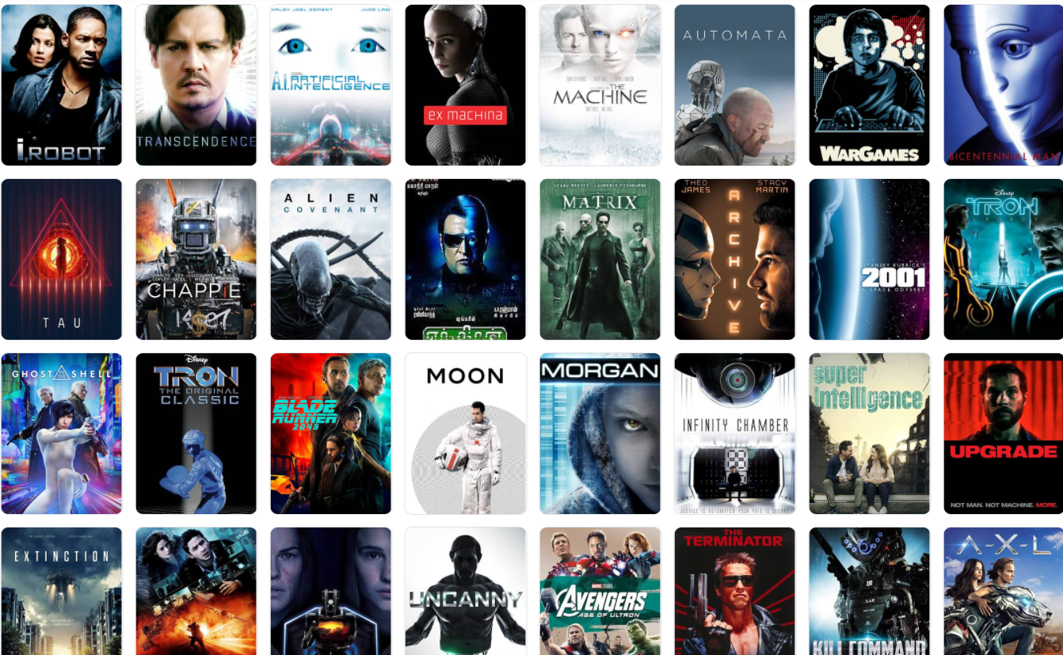
Introduction
To understand how we think → To build intelligent entities
Image Credits: Wikipedia.org

Slide 6
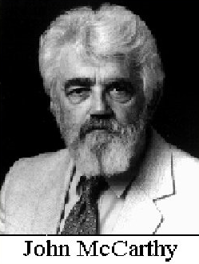
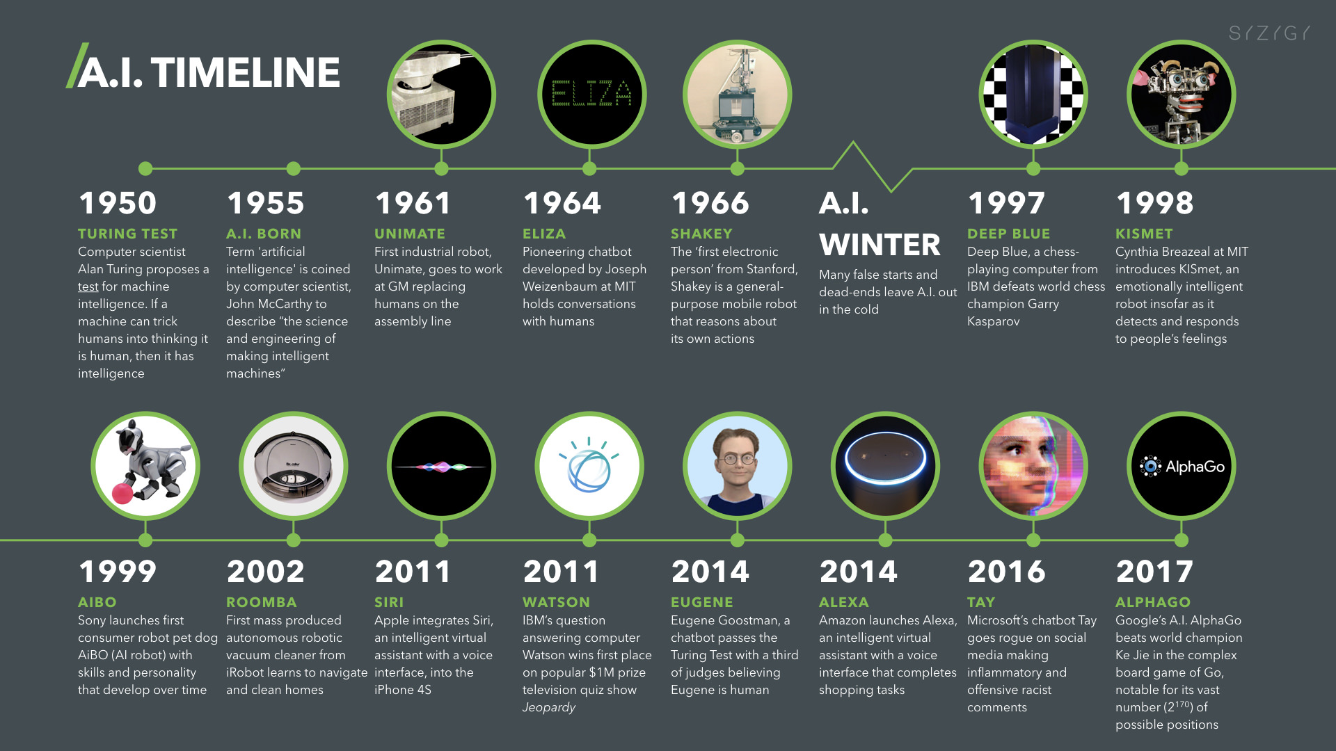
History
1943:
First mathematical model of neuron
1958: LISP
1980s:
Revival of neural networks
2000s:
Availability of Large-sized Datasets
Credits: Digitalwellbeing.org/Artificial Intelligence Timeline Infographic – From Eliza to Tay and beyond

Slide 7
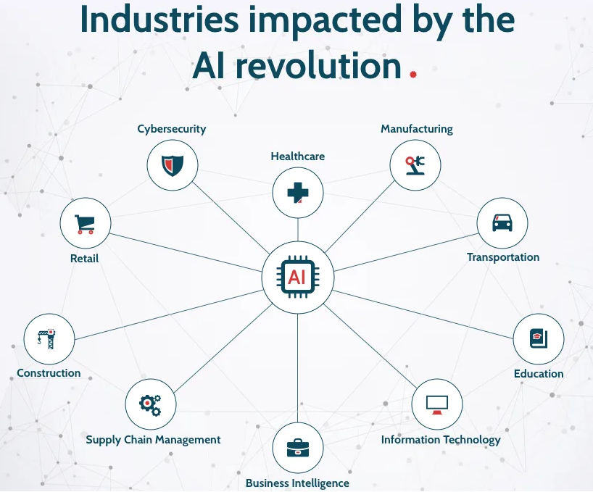
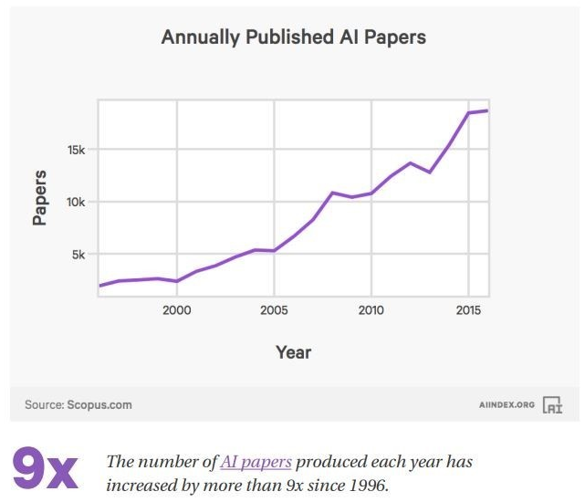
Popularity & Demand

Slide 8
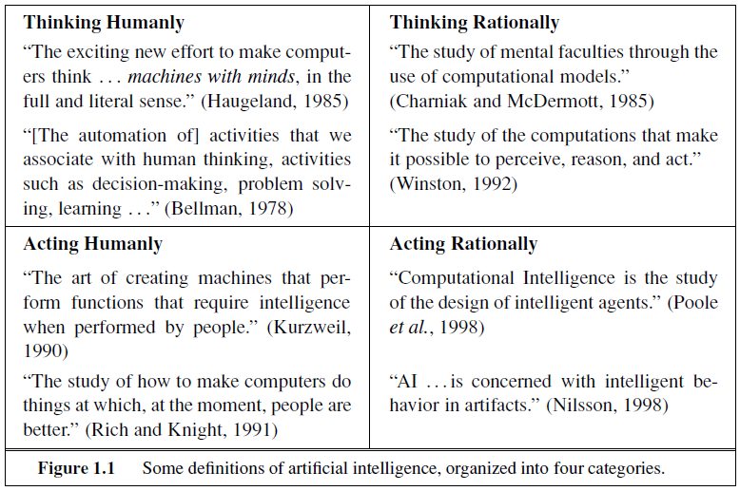
What is AI?
What is AI?
Thinking/Reasoning
Action/Behavior
Measuring Success
Exactness
Rationality

Slide 9
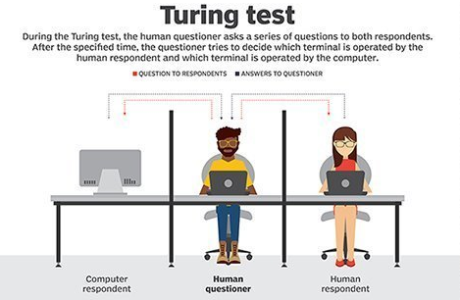

What is AI? – Human Centric Approach
ACTING HUMANLY
The Turing Test
Natural Language Processing (NLP)
Knowledge Representation
Automated Reasoning
Machine Learning
Total Turing Test
Computer Vision
Robotics
A computer would deserve to be called intelligent if it could deceive a human into believing that it was human.
-Alan Turing
Image Credits: https://searchenterpriseai.techtarget.com/definition/Turing-test

Slide 10
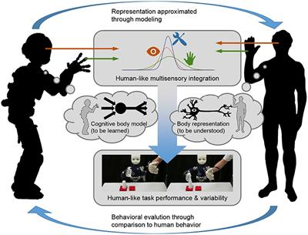
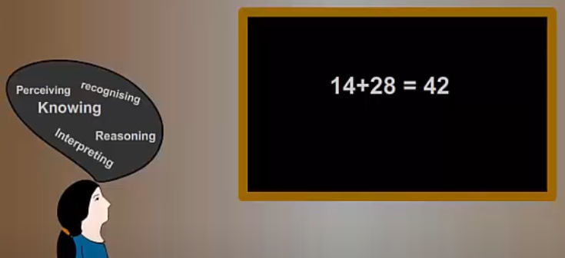
What is AI? – Human Centric Approach
THINKING HUMANLY
Cognitive Modeling
Introspection
Psychological Experiments
Brain Imaging
How machine/computer solves a problem is more important than solving a problem
Image Credits: https://www.frontiersin.org/article/10.3389/fnbot.2019.00014

Slide 11
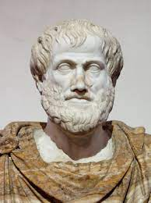
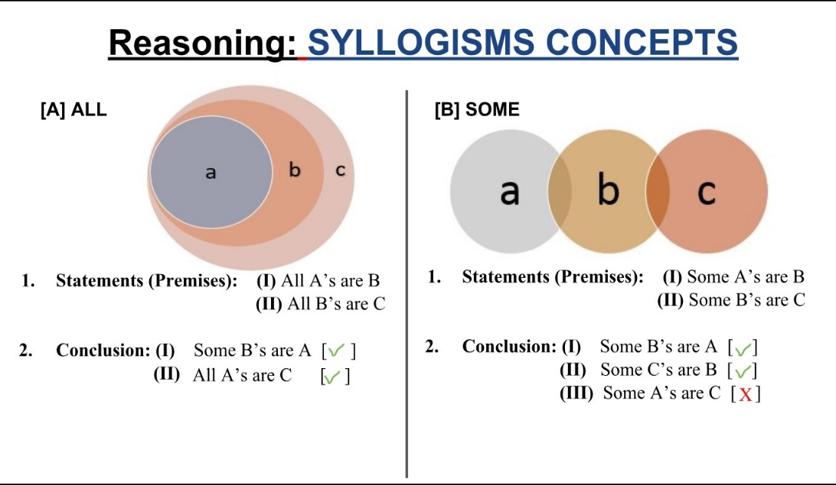
What is AI? – Rationalist Approach
THINKING RATIONALLY
Laws of Thought
“Right Thinking”
Irrefutable Reasoning
Correct premises=>Correct conclusions
Logical Notation
Challenges
Designing formal notation from informal knowledge
If no solution exists, can loop forever
Can exhaust computational resources
Image Credits: https://pierreiandtheworld.home.blog/2019/02/22/what-are-syllogisms

Slide 12
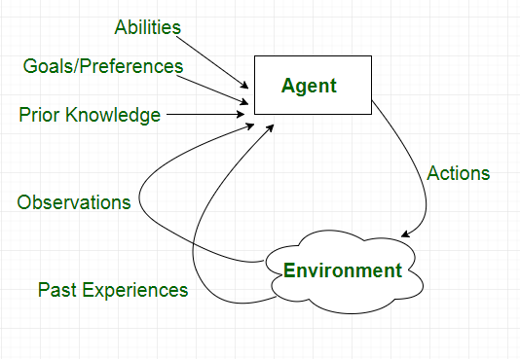
What is AI? – Rationalist Approach
ACTING RATIONALLY
Rational Agent
“A rational agent is one that acts so as to achieve the best outcome or, when there is uncertainty, the best expected outcome.”
Image Credits: https://www.geeksforgeeks.org/agents-artificial-intelligence/

Slide 13
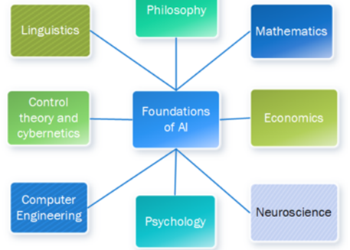
Foundations of AI
Field | AI Components
Philosophy | Logic, Knowledge Representation, Rationality
Mathematics | Formal algorithms, probability, computation
Economics | Utility, Decision theory, Sequential decisions
Neuroscience | Physical substrate for mental activity
Psychology | Perception and motor control, behaviorism, cognitive modeling
Computer Engineering | Computational Efficiency
Control theory & Cybernetics | Design systems that maximize an objective function over time
Linguistics | Language model, grammar, context
Image Credits: https://www.gopichandrakesan.com/tag/ai/

Slide 14
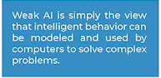
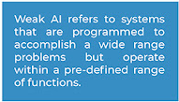
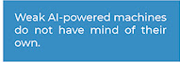

Weak AI
CAN MACHINES ACT INTELLIGENTLY?
Disability
Be kind, resourceful, beautiful, friendly, have initiative, have a sense of humor, tell right from wrong, make mistakes, fall in love, enjoy strawberries and cream, make someone fall in love with it, learn from experience, use words properly, be the subject of its own thought, have as much diversity of behavior as man, do something really new.
Mathematical objection
Theorem of incompleteness
Inconsistency
Informality
Complexity of human behavior modeling

Slide 15
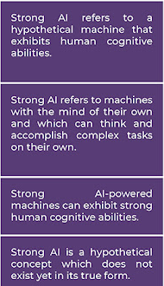
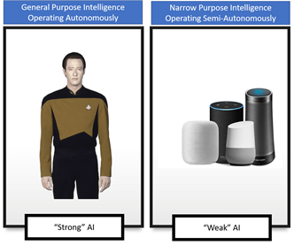
Strong AI
CAN MACHINES REALLY THINK?
Consciousness
Phenomenology
Intentionality
Mental State
Functionalism

Slide 16
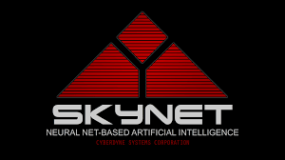

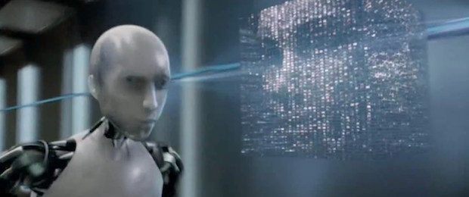
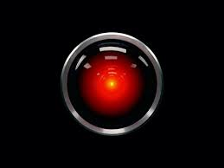
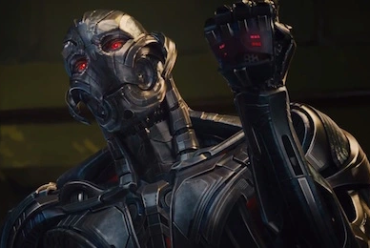
Predicted Risks Of AI
People might lose their jobs to automation.
People might have too much (or too little) leisure time.
People might lose their sense of being unique.
AI systems might be used toward undesirable ends.
The use of AI systems might result in a loss of accountability.
The success of AI might mean the end of the human race.

Slide 17
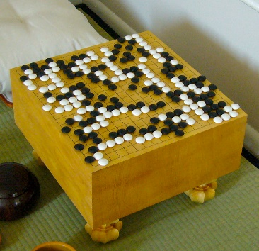
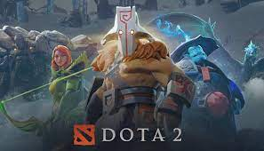
AI vs. Humans
2014-IBM Watson wins Jeopardy
2014-Google acquires DeepMind
2015-AlphaGo beats European Go champion
2016-AlphaGo beats Korean Go champion
2016-Google open-sources Tensorflow
2017-AlphaGo beats World Go champion
2017-Libratus beats World’s poker best players
2017-OpenAI bots beat World’s best Dota 2 players
2017-Elon Musk, Stephen Hawking and others write open letter to UN calling for ban on autonomous weapons

Slide 18
Assignment 1: (Optional)
Critically analyze an existing and a fictional AI machine on the basis of what you have learned in this lecture.

Slide 19
Reading Reference
The content of this lecture comprise of material from Chapter 1 and Chapter 26 of the course book.

